Slide 1

Building a News Research Tool with LangChain
This presentation explores the development of a news research tool leveraging LangChain, OpenAI, Streamlit, and NewsAPI-Python.
NN
by Nitesh Namdev

Slide 2
Introducing the Challenge: Enhancing News Discovery and Curation
The Need
Our Solution
Today's news landscape is vast and complex, demanding efficient tools for news discovery and curation.
We aim to develop a tool that leverages powerful AI and API technologies to streamline news research and analysis.

Slide 3



Leveraging LangChain: An Overview
Foundation
1
LangChain acts as a central framework for building powerful and modular language applications.
Modules
2
LangChain provides modules for data retrieval, processing, and interaction with external APIs.
Power
3
Combining these modules, we can build a sophisticated news research tool.

Slide 4
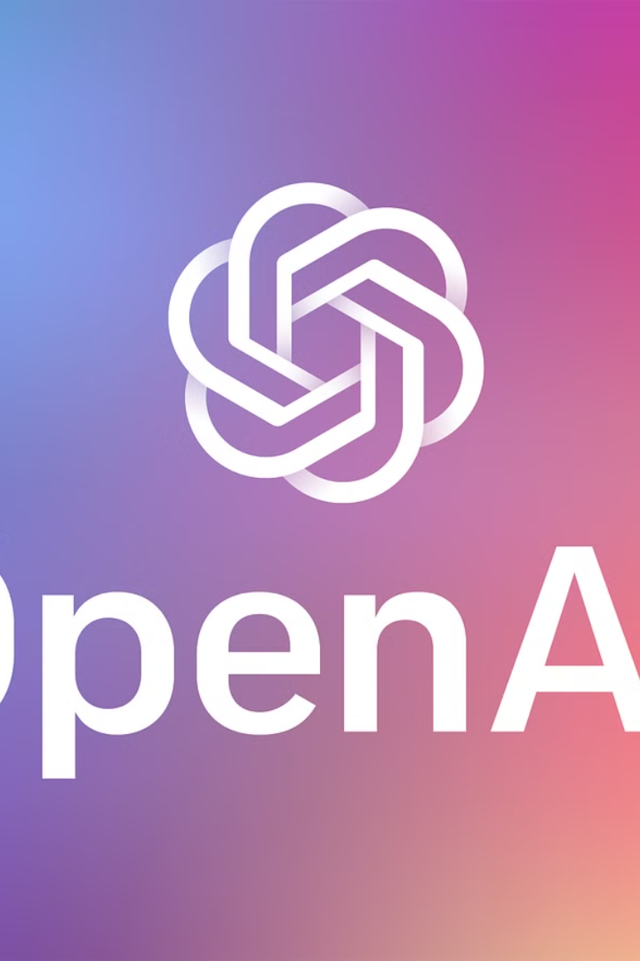


Integrating OpenAI for Language Understanding
ChatGPT
Text Embedding
OpenAI's ChatGPT provides powerful natural language processing capabilities.
OpenAI's text embedding models enable us to analyze and compare news articles.

Slide 5

Streamlining with Streamlit: Crafting the User Interface
Simplicity
Flexibility
Streamlit provides a Python-based framework for building user-friendly web applications.
We can create interactive elements for news search, filtering, and visualization.

Slide 6

Tapping into News API: Accessing Diverse News Sources
NewsAPI-Python allows us to easily access and retrieve news from multiple sources.
This ensures a wide range of news coverage and allows for comprehensive analysis.
1
2
3
We can filter news based on keywords, categories, languages, and other criteria.

Slide 7
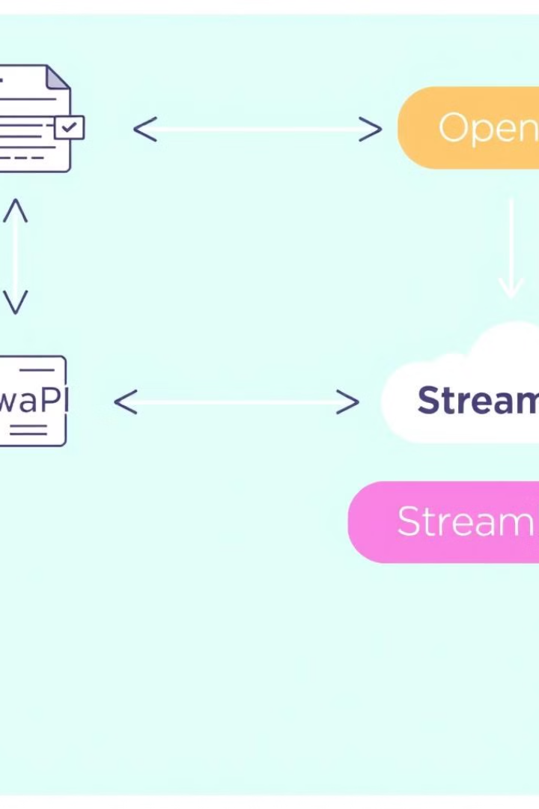




Putting it All Together: The Power of the Pipeline
News Collection
We start by gathering news articles using NewsAPI-Python, based on user queries.
Content Analysis
Next, we analyze the collected articles using OpenAI's language understanding models.
Presentation
Finally, we present the results in a user-friendly format using the Streamlit interface.

Slide 8

Conclusion and Next Steps
By combining these powerful technologies, we've built a tool for efficient news research and analysis. We will continue to refine and expand this tool to enhance its features and functionality.

